Slide 1
Auckland University of Technology ENSE706 Data Processing and Software modelling
Microtransaction Analytics System
Phase 2: Design Patterns & Refined Modelling
Name: Suemon Kwok Student: 14883335

Slide 2

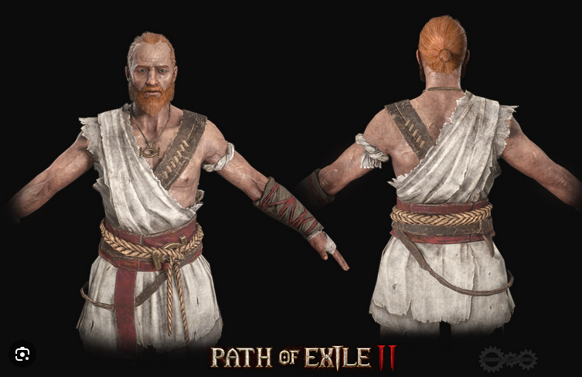
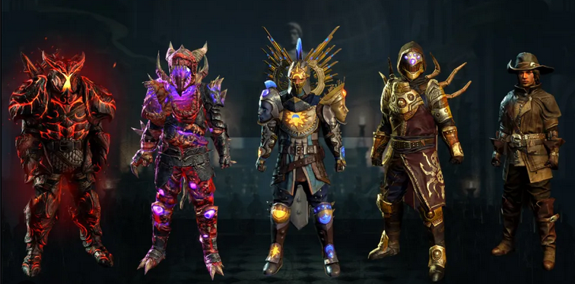
Phase 1 Recap: Premise
Company : Grind gear games
System: Microtransaction Analytics System (MAS) for Grinding Gear Games (Path of Exile)

Slide 3
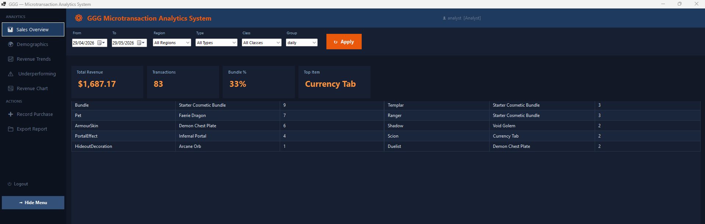
Phase 1 Recap: What Was Built

Slide 4
Phase 1 Weaknesses (Why Phase 2 Was Needed)
- ExportService.cs : 418 lines, all format logic in one switch block which violated Open/Closed Principle
- AuthService.cs : bundled session management AND data seeding which violated Single Responsibility Principle
- SeedData : 20 direct new() calls across 7 concrete item types caused tight coupling
- No audit logging pathway
- No formal export interface

Slide 5
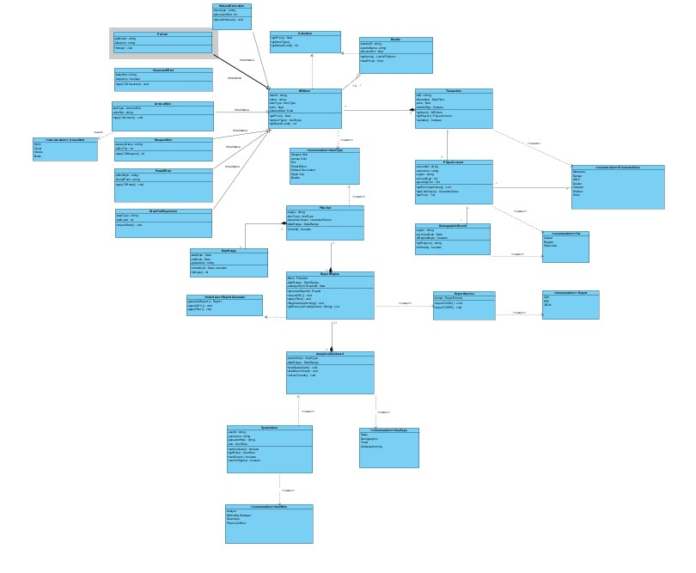
Phase 1 Class Diagram
- 27 classes: item hierarchy, transaction domain, player model, service layer
- Key weaknesses visible in structure:
- ExportService: no interface, all formats embedded
- AuthService: mixed responsibilities
- No factory, no decorator, no adapter

Slide 6
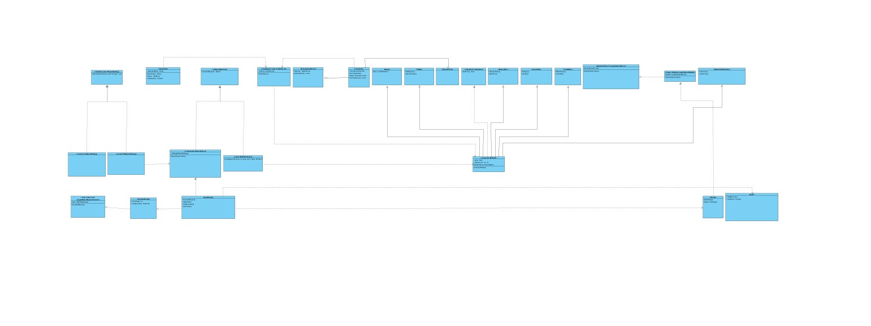
Refined Class Diagram
- Added: IExportStrategy interface + 3 concrete strategies
- Added: MTXItemFactory (dedicated creator class)
- Added: AuthService uses Singleton (sealed, private constructor)
- Added: LoggingReportEngineDecorator wrapping IReportGenerator
- Added: LegacyExportServiceAdapter bridging old and new export API
- ExportService is now a pure context class (86 lines, down from 418)

Slide 7
Five GoF Patterns Applied
Pattern | Type | Phase 1 Problem Solved
Strategy | Behavioural | ExportService switch block (OCP violation / Open/Closed principle)
Factory Method | Creational | 20 scattered new() item calls
Singleton | Creational | Multiple AuthService instances possible
Adapter | Structural | Legacy export API (Application Programming Interface) incompatible with new interface
Decorator | Structural | No audit logging without modifying ReportEngine

Slide 8
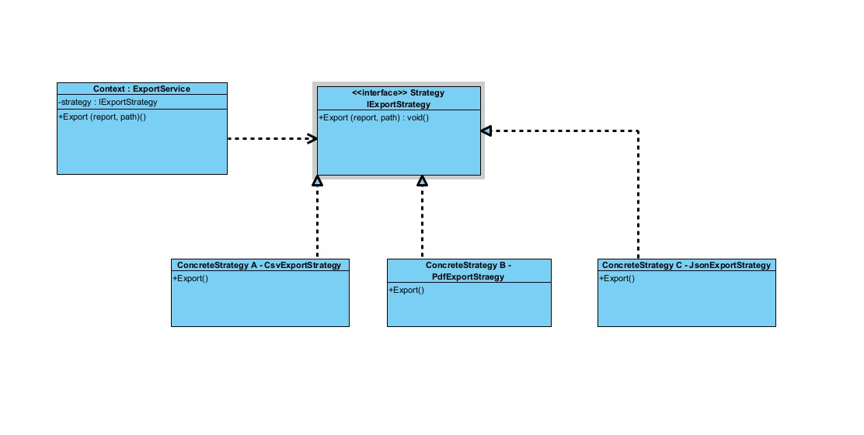
Pattern Deep Dive: Strategy
- Problem: ExportService had CSV, PDF, JSON as private methods in a switch block
- Adding a new format = editing existing working code
- Solution: IExportStrategy interface + CsvExportStrategy, PdfExportStrategy, JsonExportStrategy
- ExportService shrank from 418 to 86 lines (79% reduction)
- Adding XML export now = one new file, zero changes to ExportService

Slide 9
Pattern Deep Dive: Singleton
- Problem: AuthService held CurrentUser and session state, there nothing stopped a second instance being created
- Solution: sealed class, private constructor, GetInstance() with Lazy<T> for thread safety
- All callers use AuthService.GetInstance() which guaranteed same instance
- Trade-off: static instance persists across unit tests (test-order dependency)

Slide 10
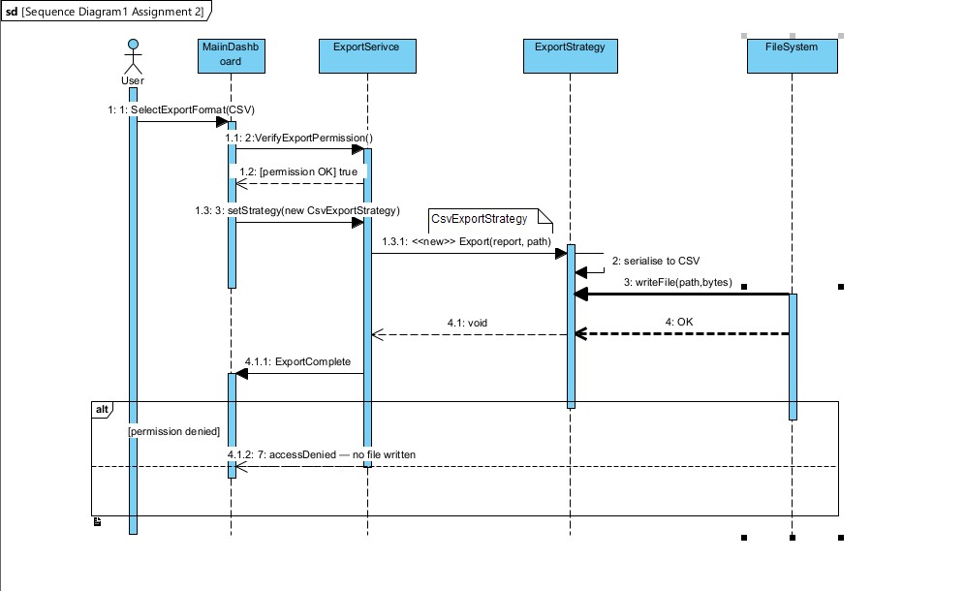
Sequence Diagram 1: Export Report
Sequence Diagram 1 : Export Report which shows Strategy delegation at runtime (UC12) ExportService calling Export() on the IExportStrategy reference - it never touches CSV logic directly.

Slide 11
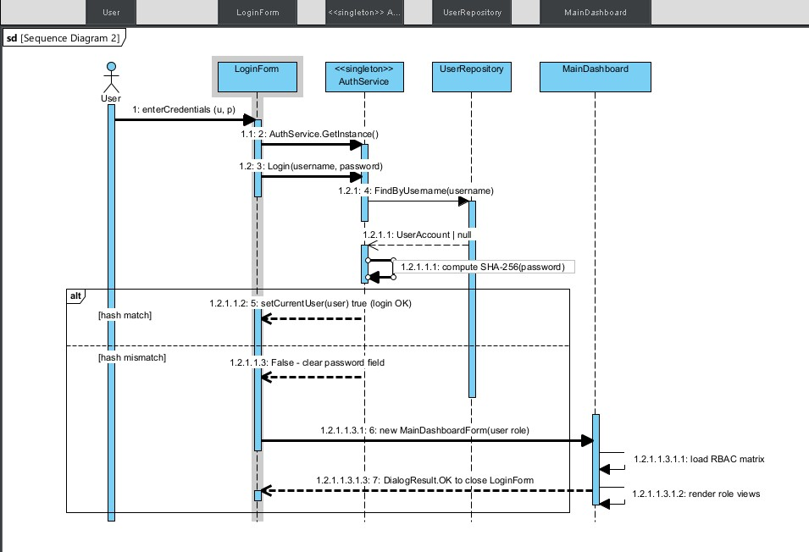
Sequence Diagram 2: Authenticate User
Sequence Diagram 2 : Authenticate User shows GetInstance() enforcement, SHA-256, RBAC loading (UC13)
Shows LoginForm calling GetInstance() rather than new AuthService()

Slide 12
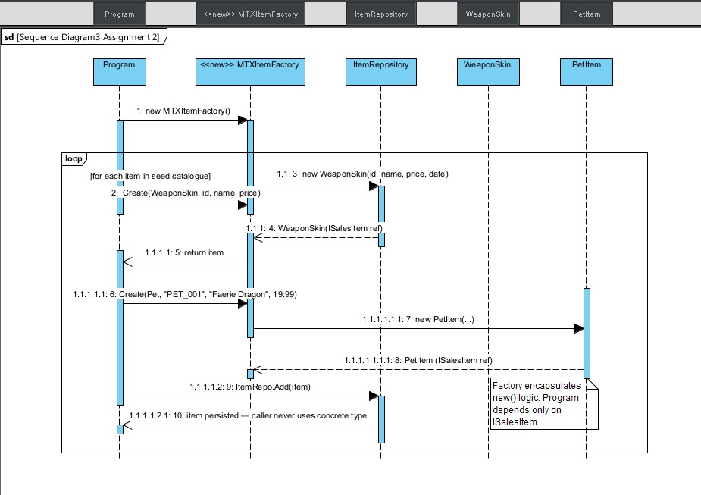
Sequence Diagram 3: Create MTX Items
Sequence Diagram 3 : Create MTX Items which shows Factory Method loop, ISalesItem return typing
Shows the seeding loop calling MTXItemFactory.Create() and receiving an MTXItem reference where Program.cs never sees a WeaponSkin or PetItem directly.

Slide 13
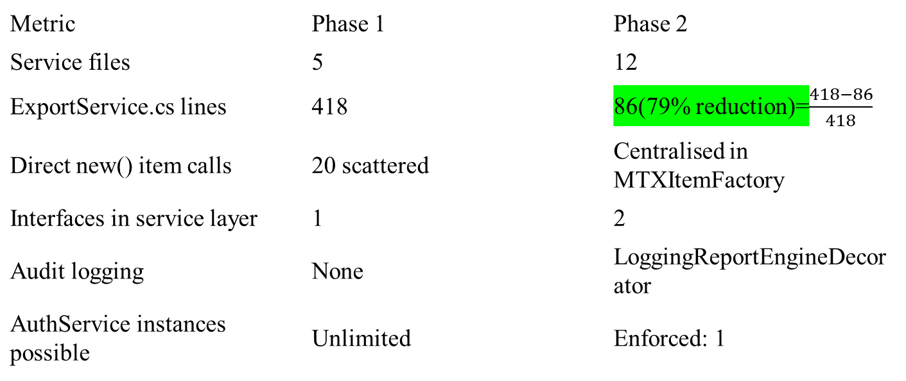
Before vs After: Key Metrics
Metric | Phase 1 | Phase 2
Service files | 5 | 12
ExportService.cs lines | 418 | 86(79% reduction)=$\frac{418−86}{418}$
Direct new() item calls | 20 scattered | Centralised in MTXItemFactory
Interfaces in service layer | 1 | 2
Audit logging | None | LoggingReportEngineDecorator
AuthService instances possible | Unlimited | Enforced: 1

Slide 14
Critical Reflection: Trade-offs
- Strategy: call chain harder to trace for new developers (one-time learning cost)
- Singleton: test-order dependency which the static instance persists across unit tests
- Adapter: risk of becoming permanent rather than transitional which needs an explicit removal plan
- Decorator: stacking order affects log content, it must be documented, not enforced by type system
- Overall: pattern application increases file count but reduces per-class complexity

Slide 15
Limitations & Future Work
- In-memory persistence: data lost on close (repository interface ready for SQL swap-in)
- Single-user session: conflicts with NFR04 (50 concurrent users) this needs session-token model
- WinForms: Windows only needs service/model layers are platform-agnostic, ASP.NET migration feasible
-SHA-256 without salt: vulnerable to rainbow tables which need BCrypt/PBKDF2 (password‑hashing algorithms) needed for production

Slide 16
Conclusion
- 5 GoF patterns applied, each resolving a documented Phase 1 weakness
- ExportService: 418 to 86 lines via Strategy
- Item creation centralized via Factory Method
- Session integrity enforced via Singleton
- Legacy API bridged via Adapter
- Audit logging added via Decorator; zero changes to ReportEngine
- UML and C# kept in sync throughout

Slide 17
Questions
Thank you
GitHub: https://github.com/Suemon-Kwok/ENSE706-Data-Process-and-Software-Modelling-2026-S1---Microtransaction-Analytics-System---14883335

